Slide 1
FAMILY/SELF PAY
RENEWAL
Emails:
Sent by BSA National.
Beginning 60 days before expiration.
Unit Key 3 will receive on 1st and 15th.
Important Information:
Parent must have a my.scouting.org account to renew online.
Parent’s account must be linked to all children.
Parent must have a relationship linked in the council system.

Slide 2
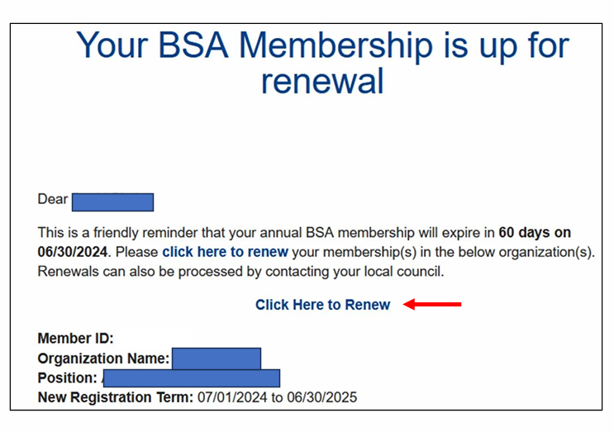
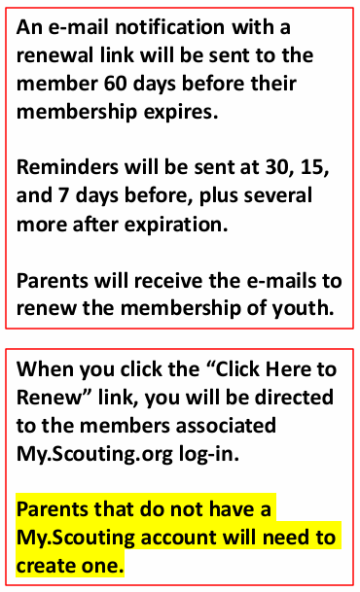
FAMILY/SELF PAY
RENEWAL

Slide 3
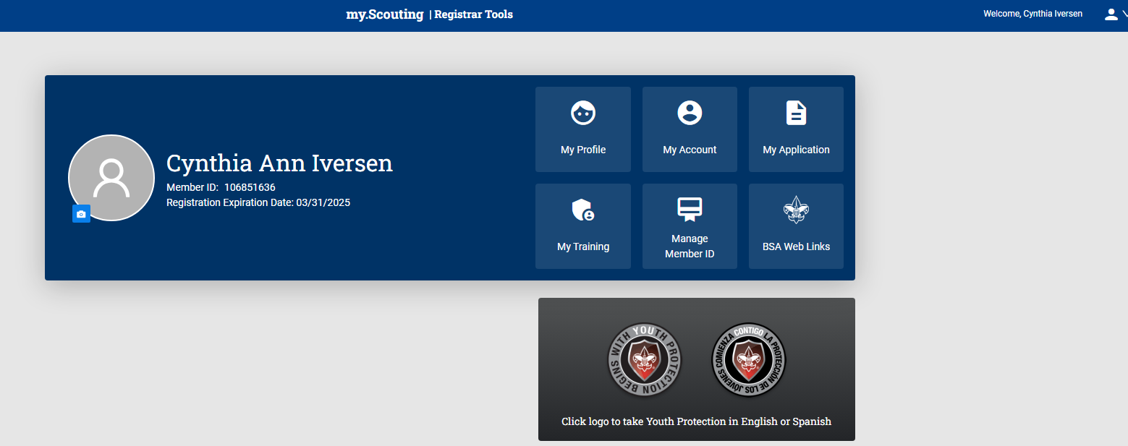
FAMILY/SELF PAY
RENEWAL
Option 1: Individual Registration Renewal
Click on emailed link. Will be directed to my.scouting.org.
OR
Log into my.scouting.org account and click on red notification.
Log into my.scouting.org and click on My Application

Slide 4
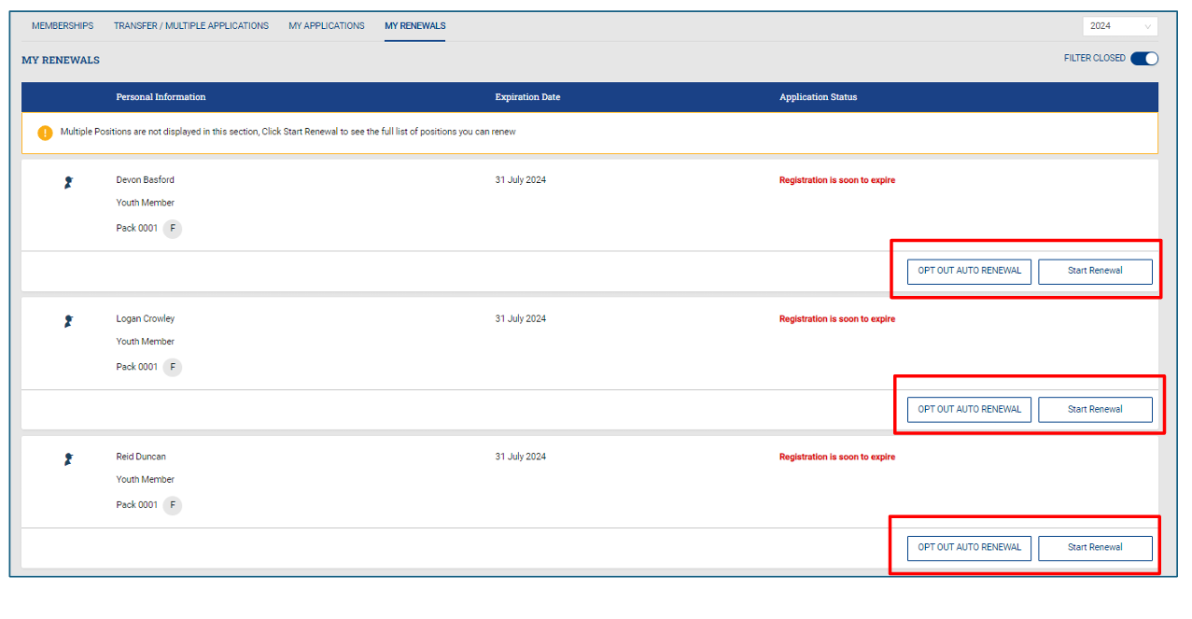
FAMILY/SELF PAY
RENEWAL
Of not continuing in Scouting, select “Opt Out of Auto Renewal.
Select “Start Renewal.”
Renewals will be completed one at a time.

Slide 5
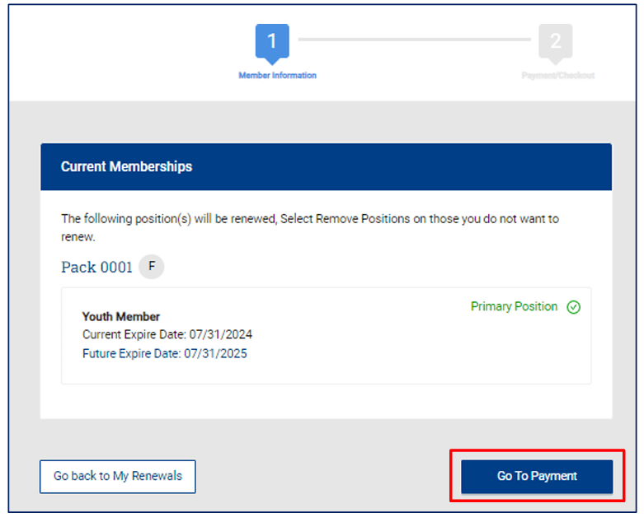
FAMILY/SELF PAY
RENEWAL
All positions eligible for renewal will show.
Mark appropriate position as primary.
Review.
Click “Go To Payment.”

Slide 6
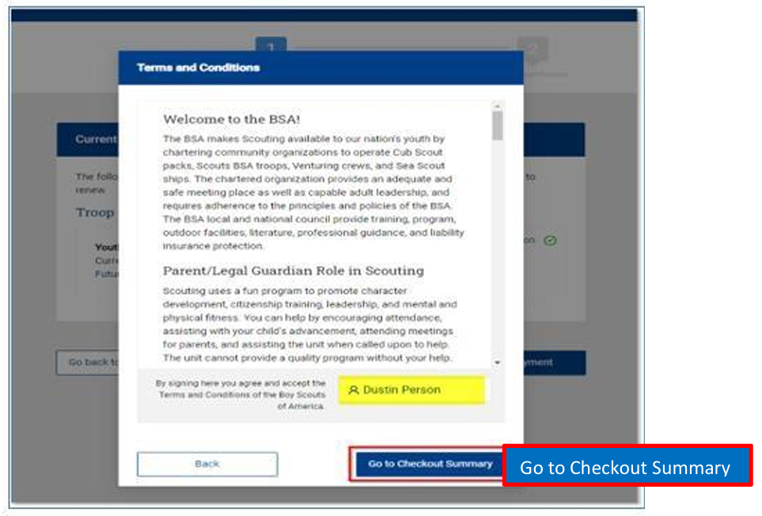
FAMILY/SELF PAY
RENEWAL
Sign and agree to Terms & Conditions.
Click “Go To Checkout Summary.”

Slide 7
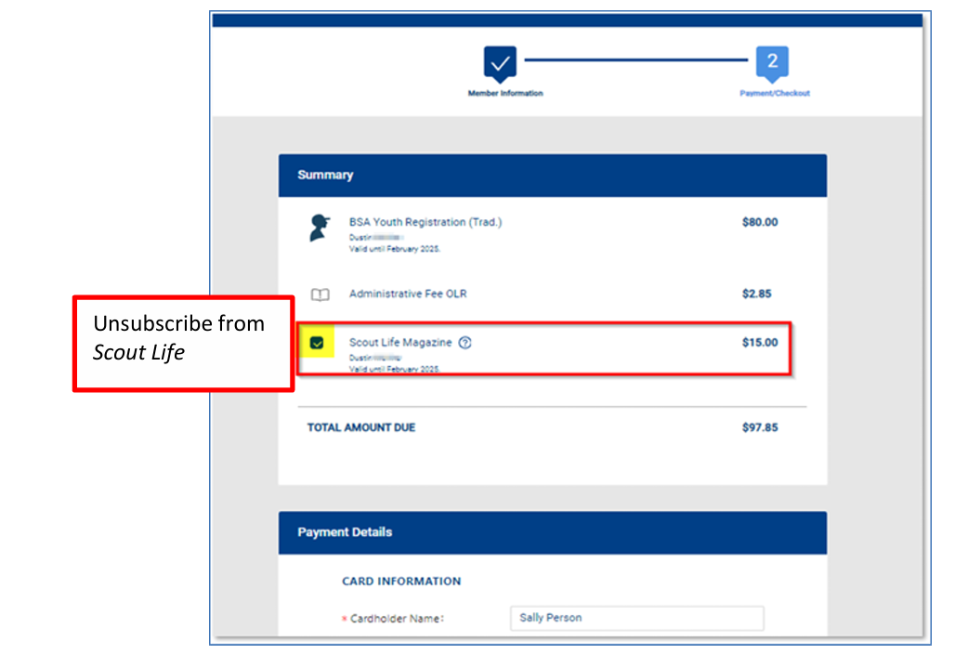
FAMILY/SELF PAY
RENEWAL
Adjust Scout Life subscription.
Proceed to enter credit card information.

Slide 8
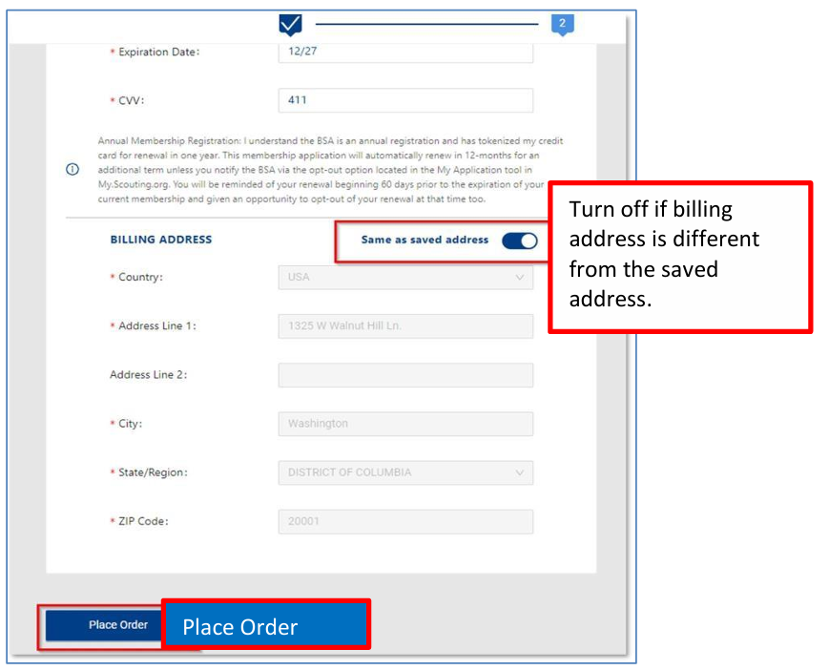
FAMILY/SELF PAY
RENEWAL
Defaults to address on file.
Confirm address is credit card billing address.
Change is necessary.
Click “Place Order.”

Slide 9
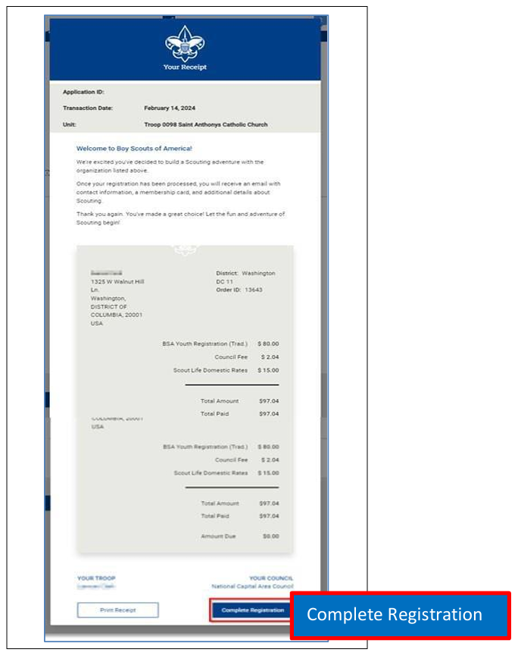
FAMILY/SELF PAY
RENEWAL
Once process completed, receipt will be displayed.
Click “Complete Registration.”

