Slide 1
UNIT PAID
RENEWAL
Important Notes:
Only done by unit Key 3.
Units can select individuals to renew.
Can be done more than once per month.
Renewal period begins 60 days prior and ends 90 days after expiration date.
To Begin:
Log into my.Scouting.org account.
Select unit.
Organization Manager > Roster.

Slide 2
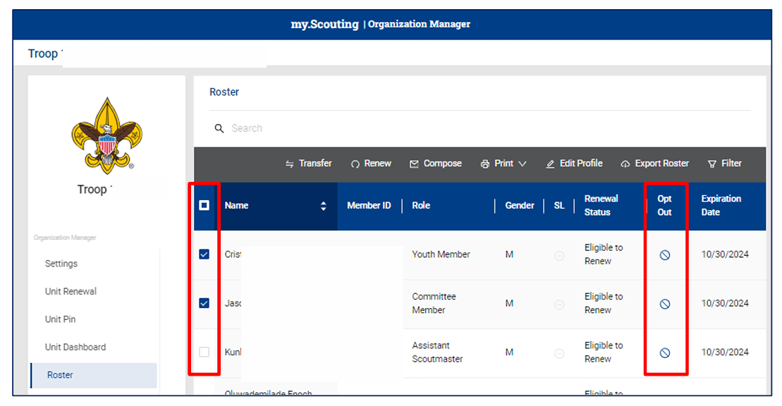
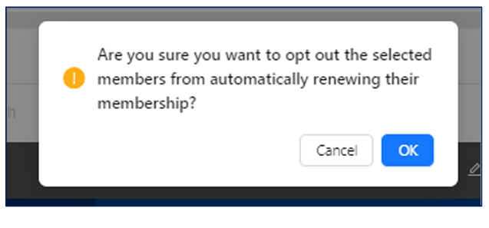
UNIT PAID
RENEWAL
If individual is no longer active, select “Opt-Out.”
Only council can unselect.

Slide 3
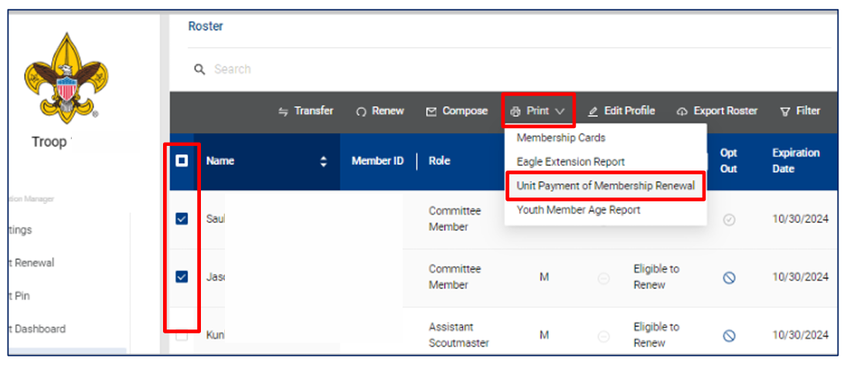
UNIT PAID
RENEWAL
PAY AT COUNCIL:
Select members unit will renew.
Click “Print.”
Select “Unit Payment of Membership Renewal.”
Submit page to council with payment.

Slide 4
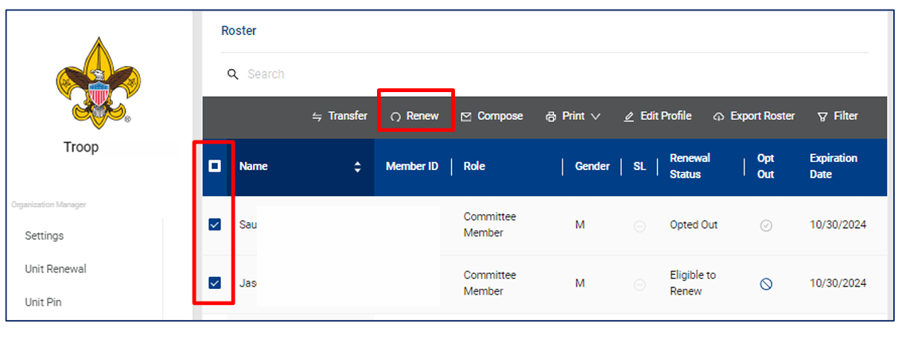
UNIT PAID
RENEWAL
PAY ONLINE:
Select members unit will renew.
Click “Renew.”

Slide 5
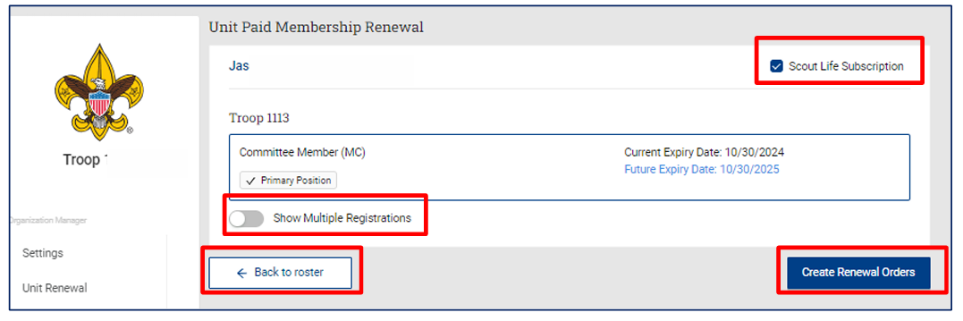
UNIT PAID
RENEWAL
PAY ONLINE:
Only membership for your unit will show.
Select “Show Multiple Registrations if individual has more than one registration in your unit.
Click “Create Rewewal Orders.”
Scout Life subscription is selected by default.
Uncheck box if not subscribing.

Slide 6
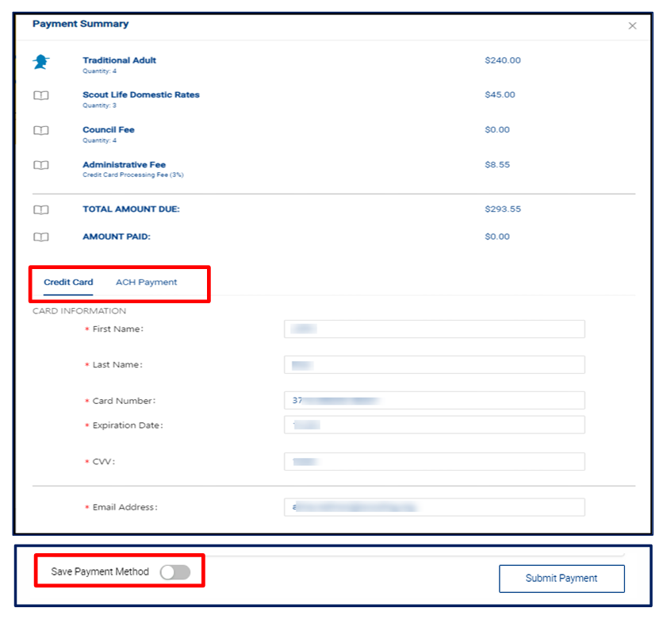
UNIT PAID
RENEWAL
PAY ONLINE:
Payment Summary displays recap of fees.
If first time, you will need to enter payment information.
ACH payment fee is $1.00.
Credit Card payment fee is 3%.
You can securely store payment method for future use.
Select “Submit Payment.”

Slide 7
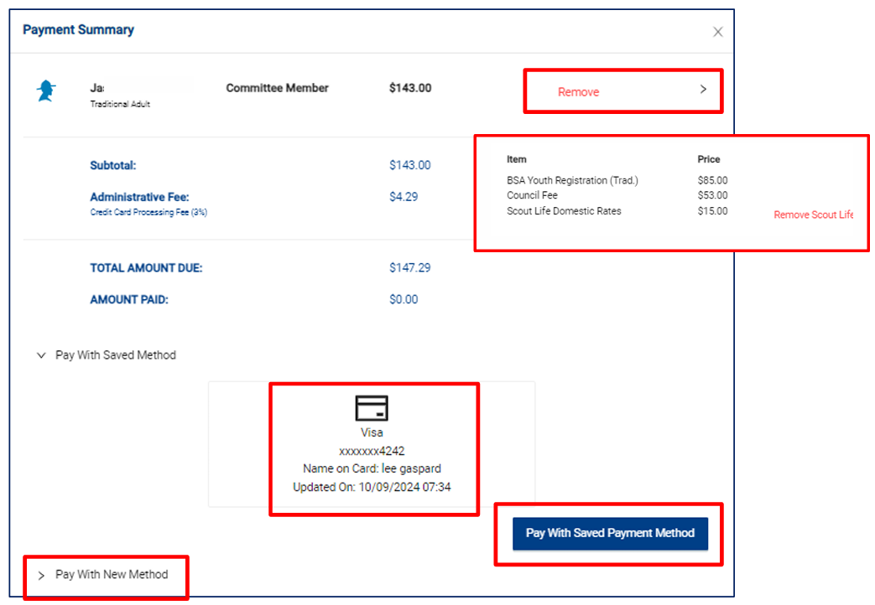
UNIT PAID
RENEWAL
PAY ONLINE:
If payment method saved, option to use this or pay with new method.
Changes can be made to renewal.
Registration changes may be made.

Slide 8
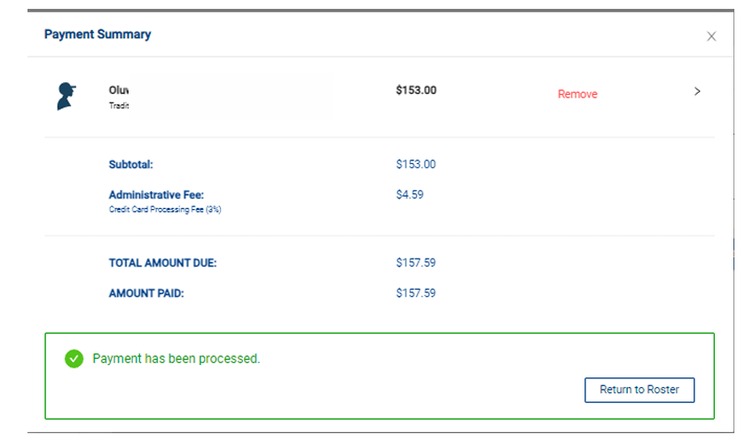
UNIT PAID
RENEWAL
PAY ONLINE:
When processed, “Payment Summary” will display.
Print for your records.

Slide 9
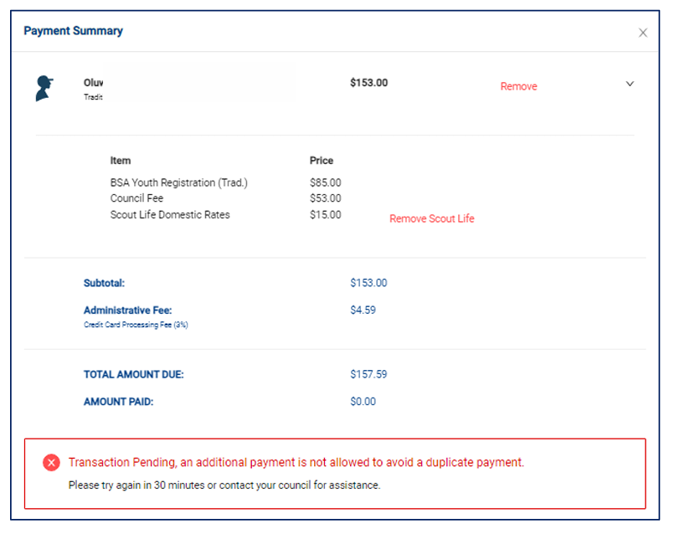
UNIT PAID
RENEWAL
PAY ONLINE:
If payment submitted with last 30 minutes, “Transaction Pending” will display.
Prevents duplicate payments.

