Slide 1
U
N
I
T
R
E
N
E
W
A
L
Tips for Successful Unit Renewal
Unit Key 3 only, not delegates.
Unit renewal does not renew membership.
Renewal eligible 60 days prior to expiration.
Pre-check requirements.
Required leadership positions.
Youth Protection Training.
Youth do not meet age/grade requirement.
Work with the District Executive to submit an Annual Charter Agreement.

Slide 2
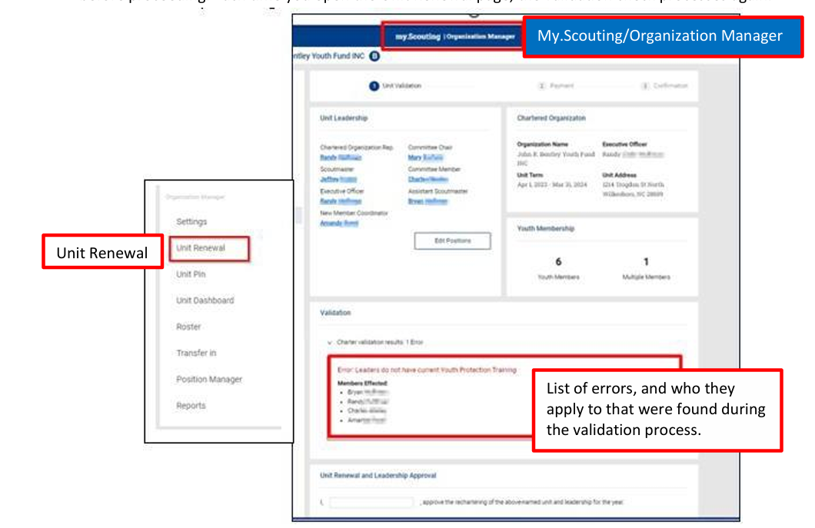
U
N
I
T
R
E
N
E
W
A
L
Log into my.Scouting.org.
Menu>Organization Manager>Unit Renewal.
Automatically runs validation process.

Slide 3
U
N
I
T
R
E
N
E
W
A
L
Validation Codes in Unit Renewal:
Errors (red) will not let you proceed.
Warnings (yellow) will allow you to proceed.
Leaders do not have current Youth Protection Training – Error.(most common)
Unit does not have required number of leadership positions – Error.
Leaders are less than 18 years old – Error
Youth do not meet the age/grade requirement for the program – Error.
Leaders do not have completed CBC Authorizations – Warning

Slide 4
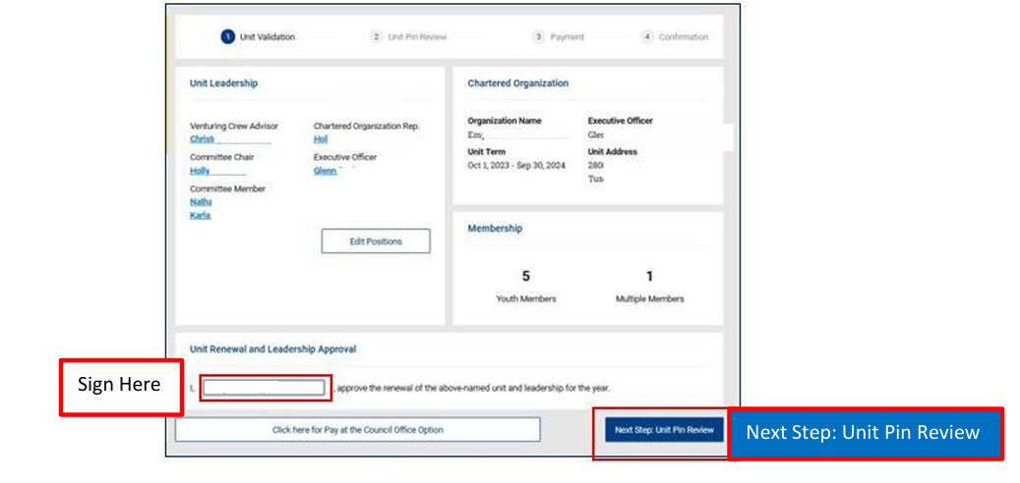
U
N
I
T
R
E
N
E
W
A
L
Resolve validation errors.
“Sign” the renewal.
Select “Next Step: Unit Pin Review.”

Slide 5
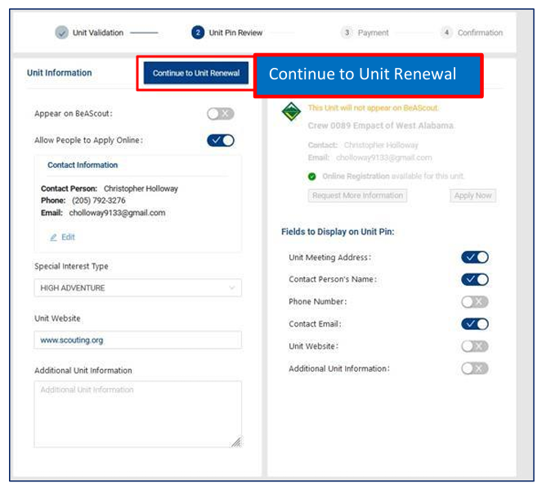
U
N
I
T
R
E
N
E
W
A
L
Update contact information, if necessary.
“Appear on BeAScout” toggled on.
Select fields to show.
Select “Continue to Unit Renewal.”

Slide 6
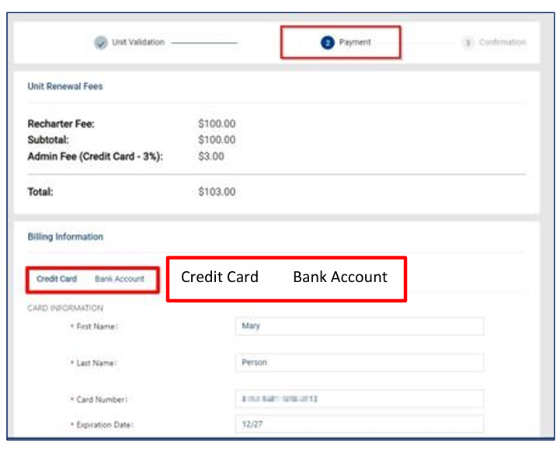
U
N
I
T
R
E
N
E
W
A
L
Select “Credit Card” or “Bank Account.”
ACH fee is $1.00.
Credit card fee is 3%.

Slide 7
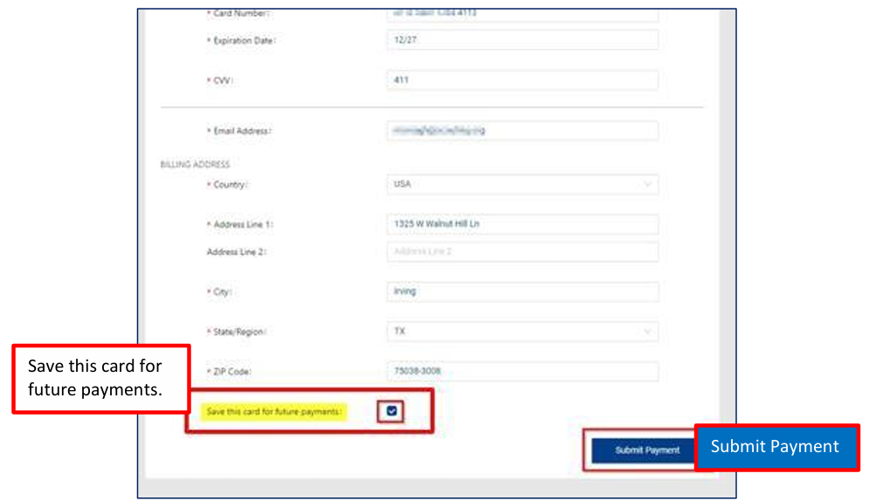
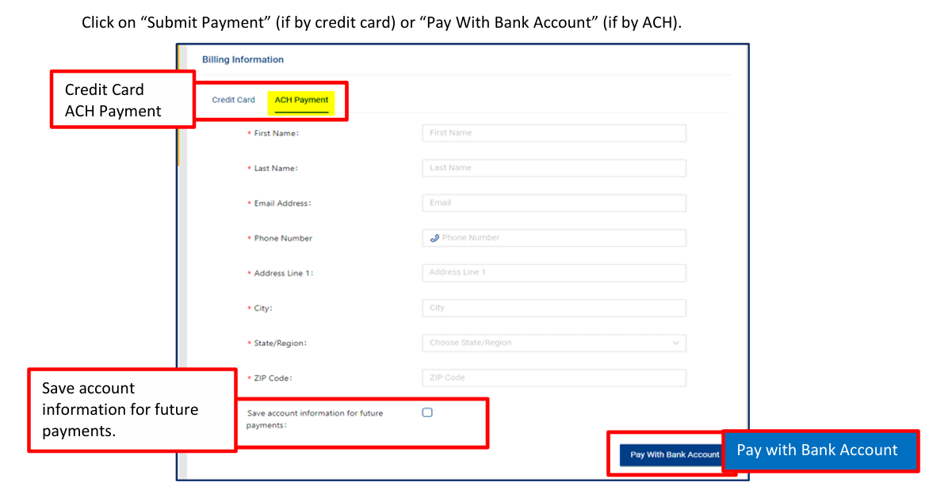
U
N
I
T
R
E
N
E
W
A
L
Can securely save payment information for future use.
Paying with credit card, select “Submit Payment.
Paying by ACH, select “Pay with Bank Account.”

Slide 8
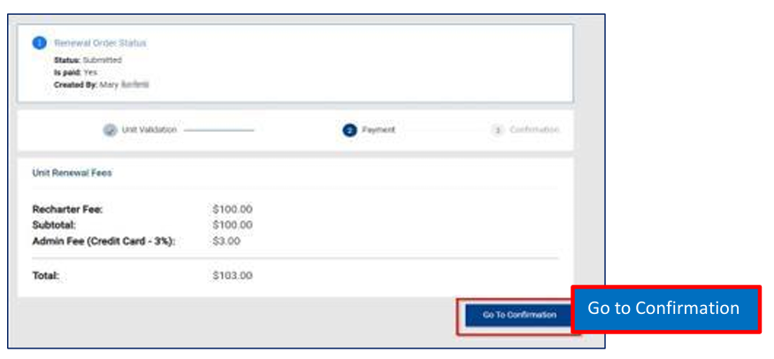
U
N
I
T
R
E
N
E
W
A
L
Review the fees.
Select “Go to Confirmation.”

Slide 9
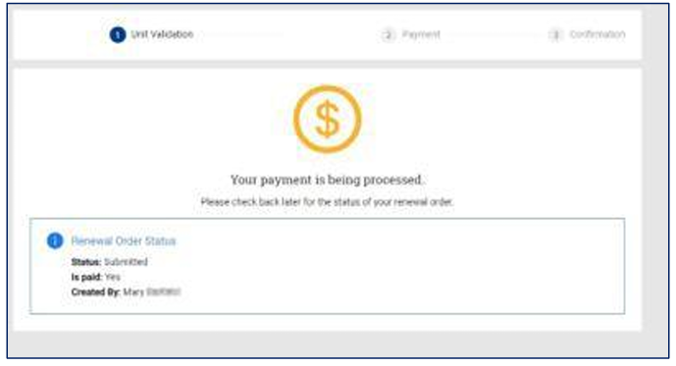
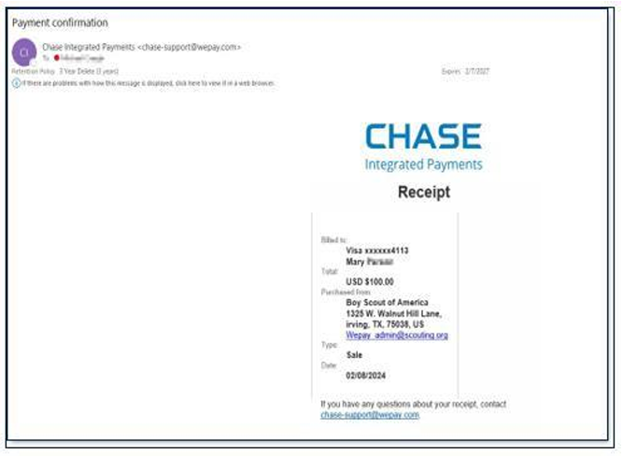
U
N
I
T
R
E
N
E
W
A
L
Once you see the payment processing and confirmation pages, an email confirmation and receipt will be sent to email provided in billing information.
Your unit is now submitted for renewal!

Slide 10
U
N
I
T
R
E
N
E
W
A
L
Once you see the payment processing and confirmation page, an email confirmation and receipt will be sent to email provided in billing information.

